Slide 1
Bank Management System
Name: Manjula B
Employee Id: 5770
ArisGlobal Professional Service Developer Track
Date: 28/12/2021

Slide 2
Bank Management System
A Computer based management system is designed to handle all the primary information in banks.
Bank Management System is an application used to manage the services provided by the bank through online.
This application helps to reduce the manual work of the bank staffs.
This is a web application used by a bank admin to carry out all the bank procedures.

Slide 3
Bank Management System
Tools and technologies used
Server-side technologies
Spring Boot - 2.0.5.RELEASE
Spring Framework - 5.0.8 RELEASE
Hibernate - 5.2.17.Final
Spring Data JPA - 2+
MySql
Front end technologies
Angular 9
Bootstrap 4
npm- 6.9.0

Slide 4
Bank Management System
Tools
Maven - 3.2+
IDE - Spring Tool Suite (STS) // Spring boot API development
Visual Studio Code // Angular App development
Angular CLI

Slide 5
Bank Management System
Project Modules
Create User Account
Manage User Account
Update Details
Delete Details

Slide 6
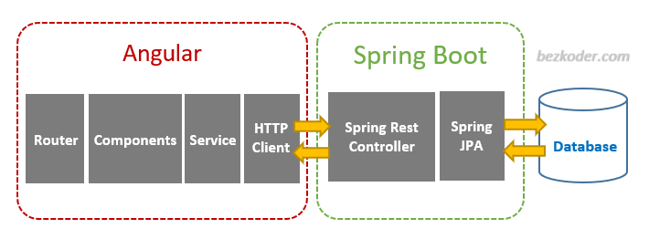
Bank Management System
Angular 11 & Spring Boot CRUD Architecture

Slide 7
Bank Management System
Screenshots

Slide 8
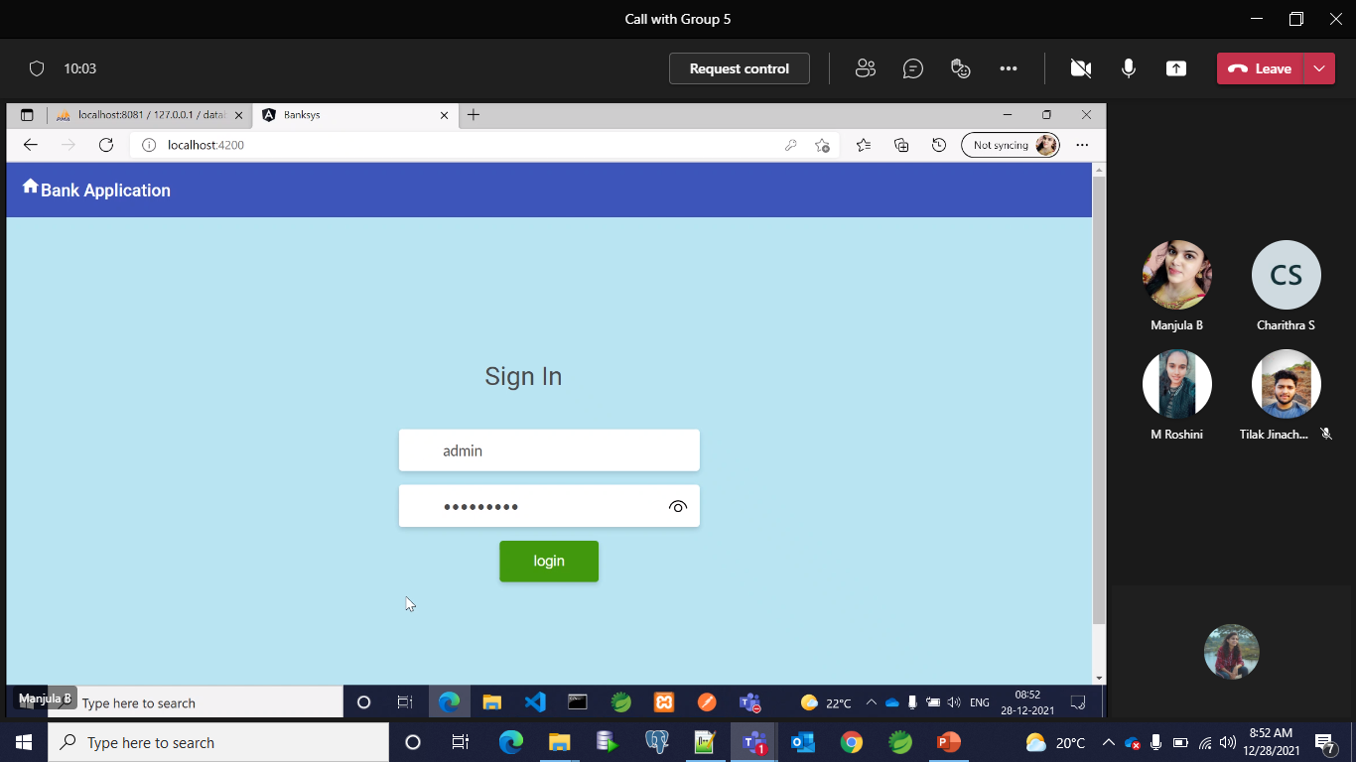
Bank Management System
Login

Slide 9
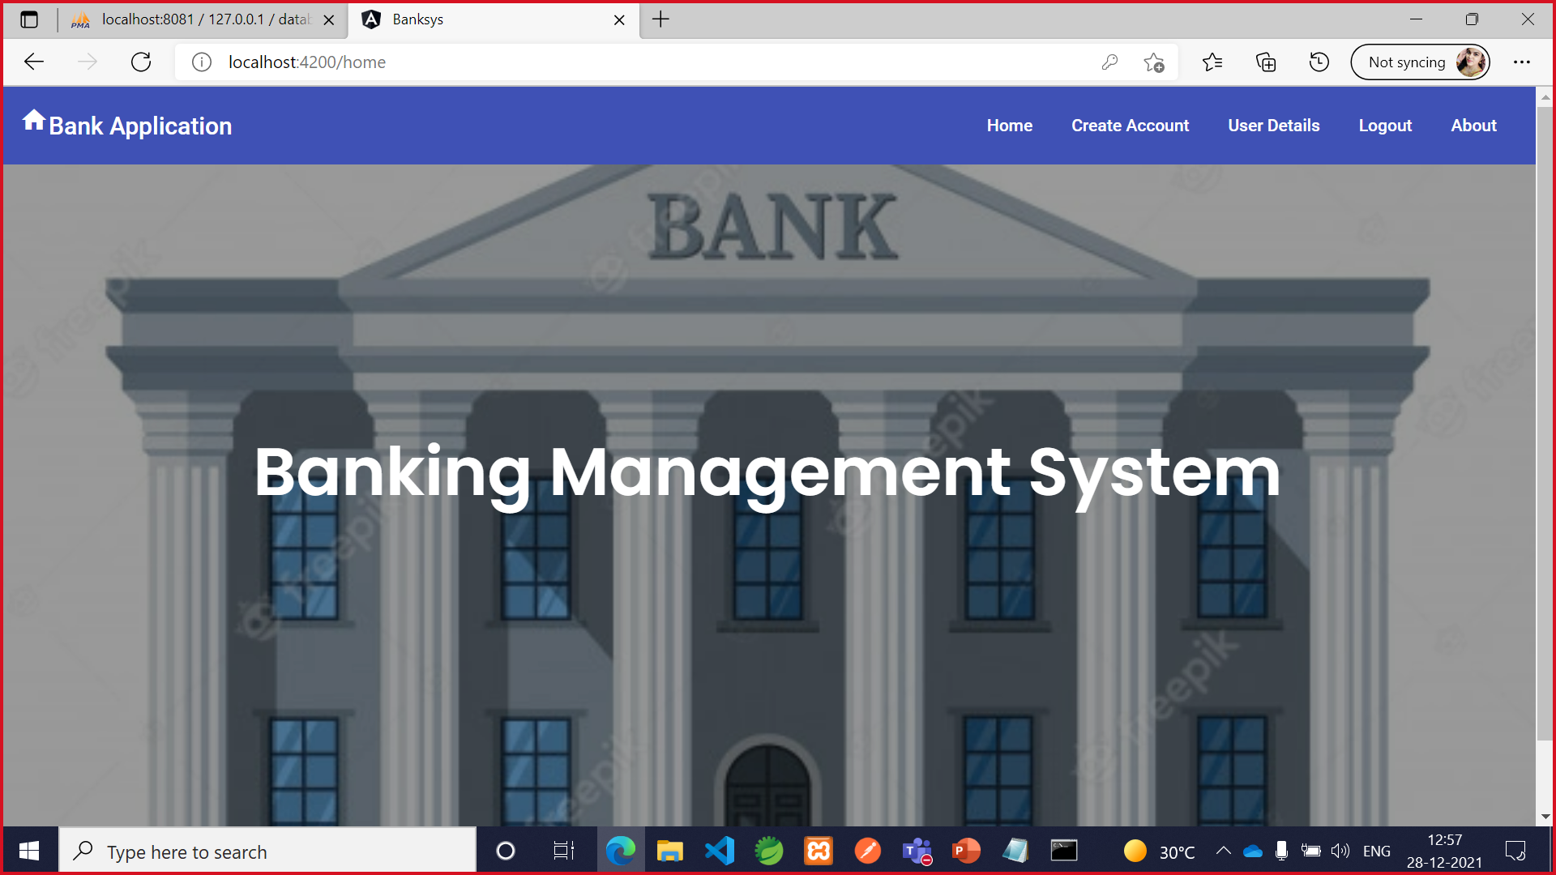
Bank Management System
2. Home Page

Slide 10
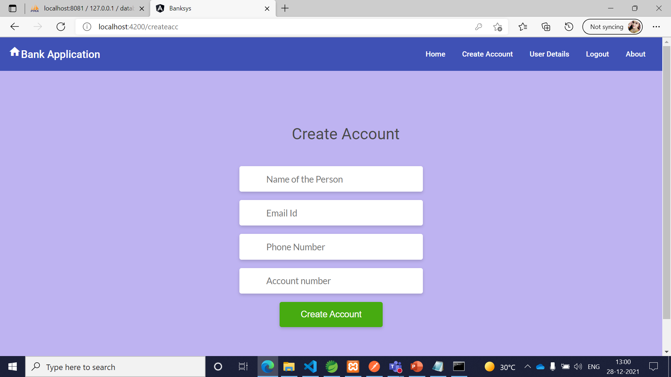
Bank Management System
3. Create Account

Slide 11
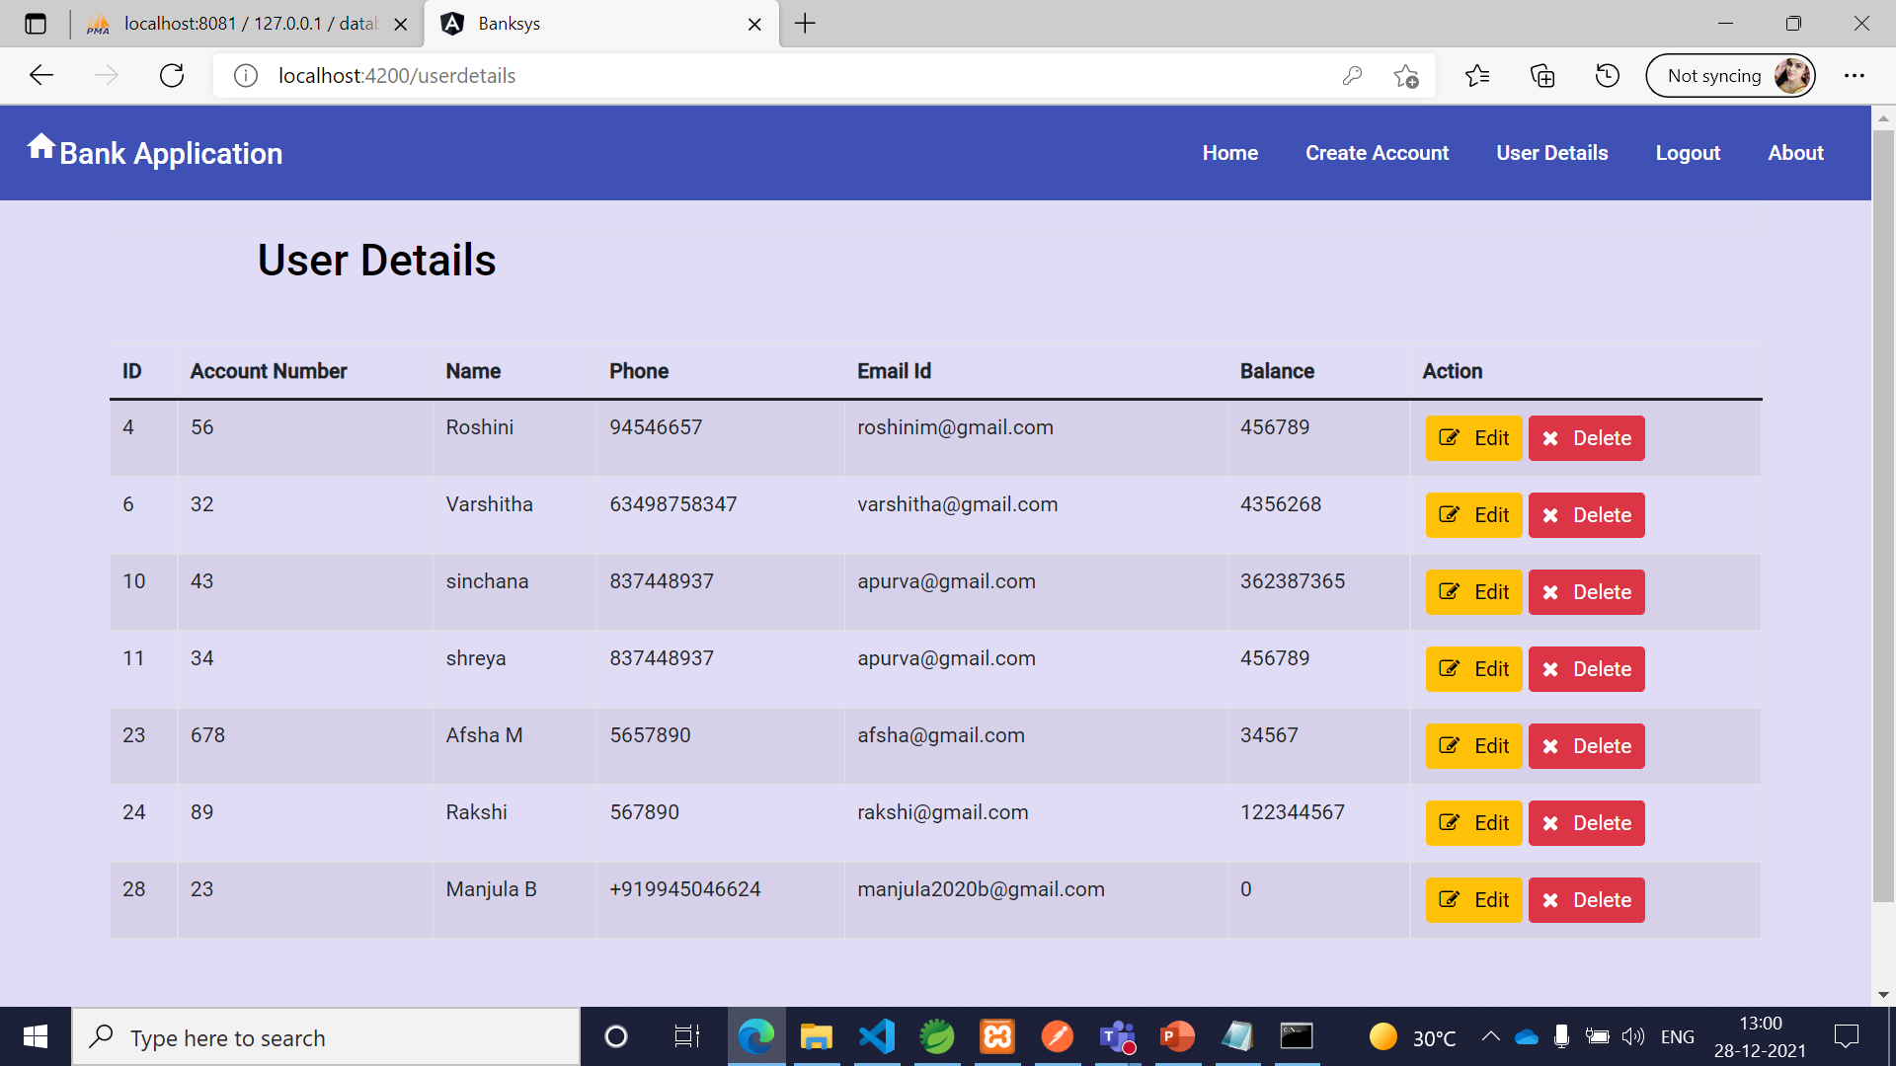
Bank Management System
4. View User Details

Slide 12
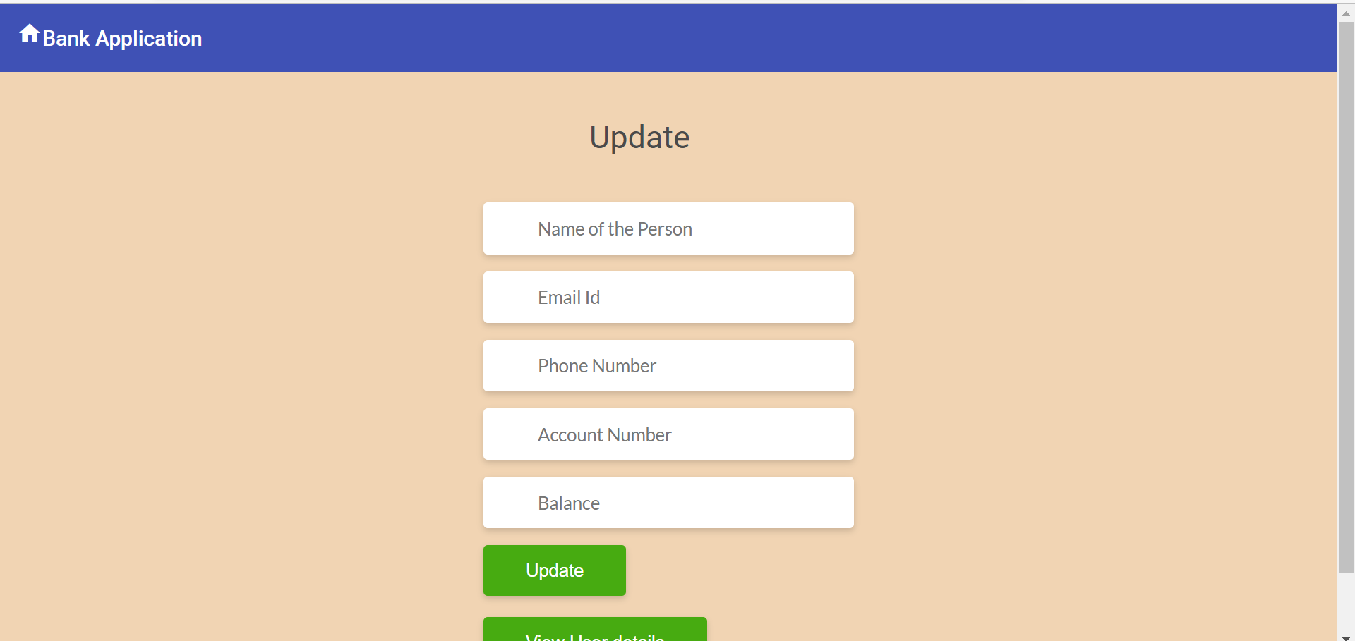
Bank Management System
5. Update

Slide 13
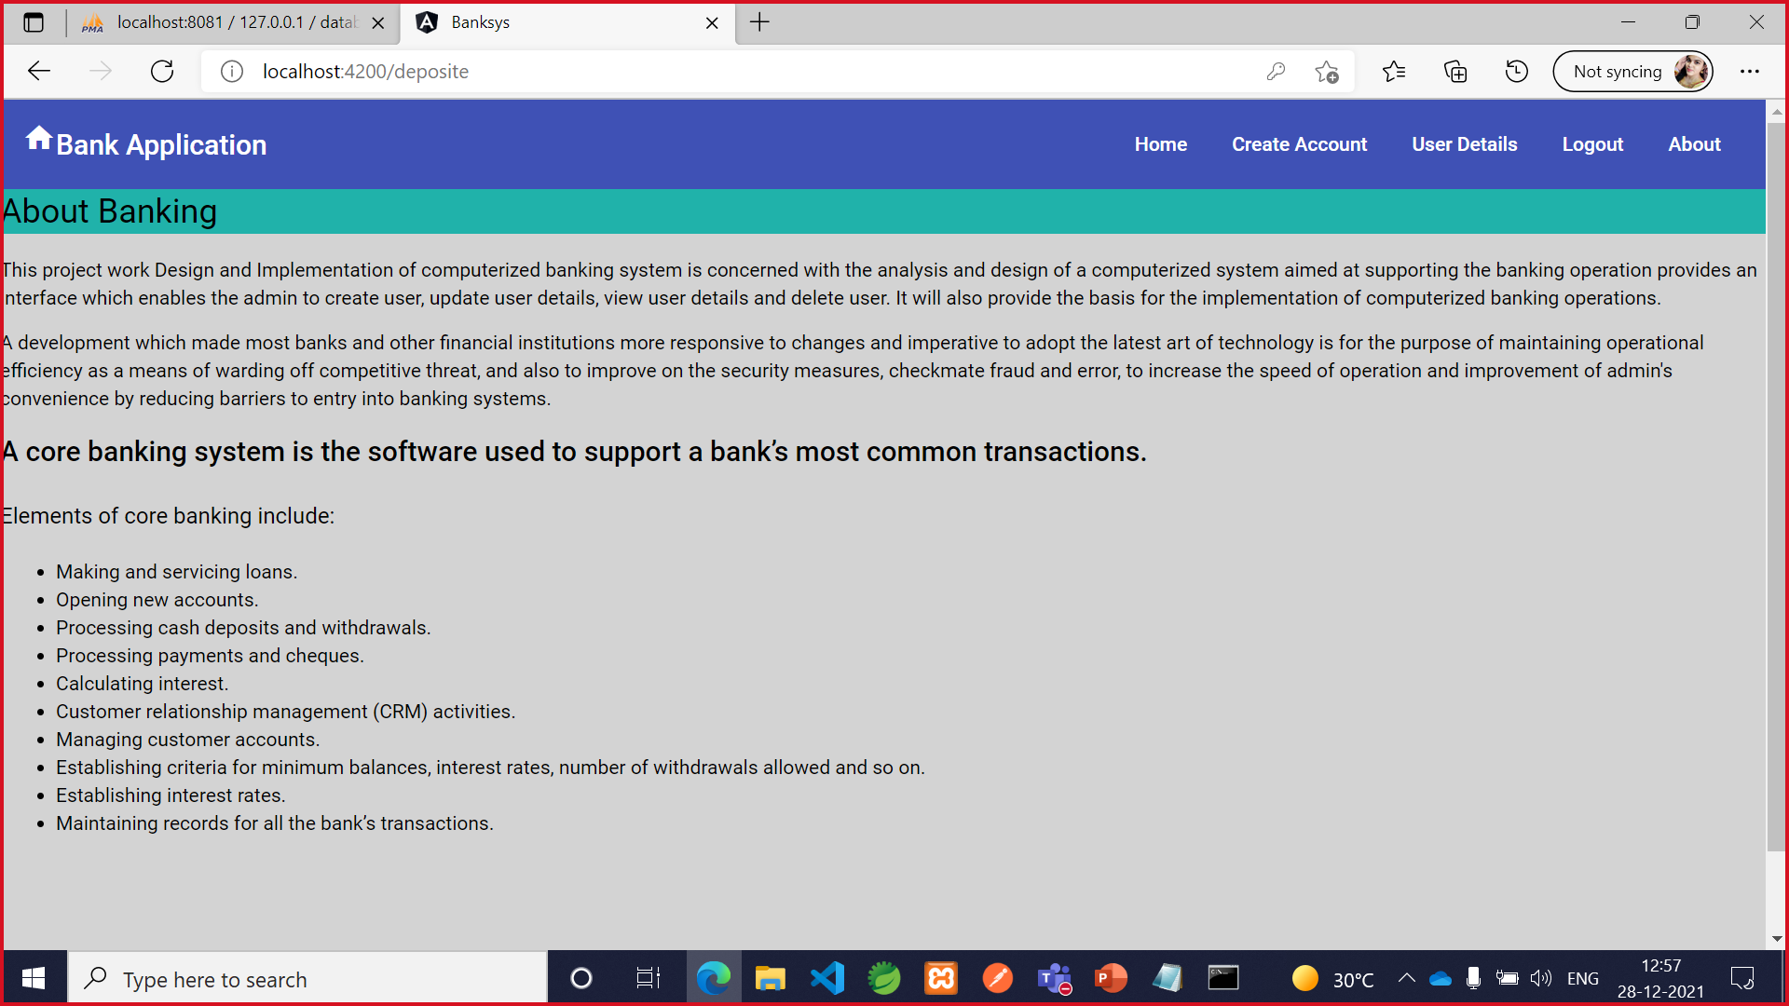
Bank Management System
6. About

Slide 14
Bank Management System
Thank you

